Slide 1
Understanding the In-and-Outs of FMLA Eligibility, Notice, and Absences
February 19, 2026

Slide 2
Introduction to ComplianceHR

Slide 3
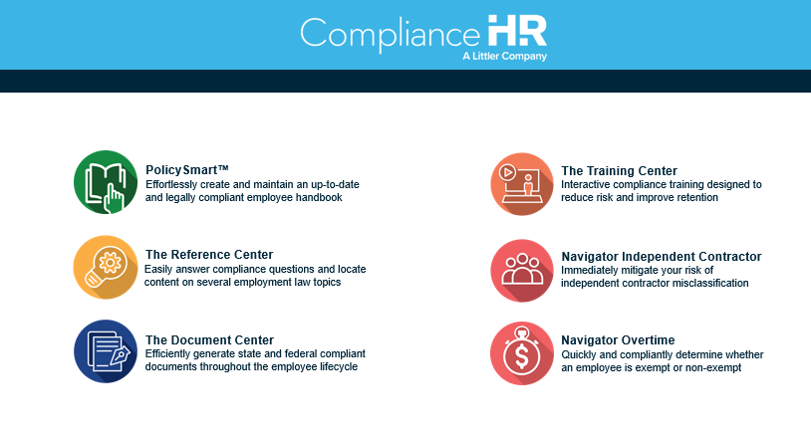
Simplify the Complexity of Employment Law

Slide 4

Reference Center
Stop guessing with Google.
Access a single, verified source of truth for all employment law questions to get outside-counsel quality answers in seconds.
✓ Littler Attorney-authored, continuously updated content.
✓ Content sourced directly from Littler expertise.
✓ Comprehensive federal, state, and local coverage.
30+ topics including FMLA, minimum wage, final pay, workplace posters, pay transparency, predictive scheduling, and more

Slide 5
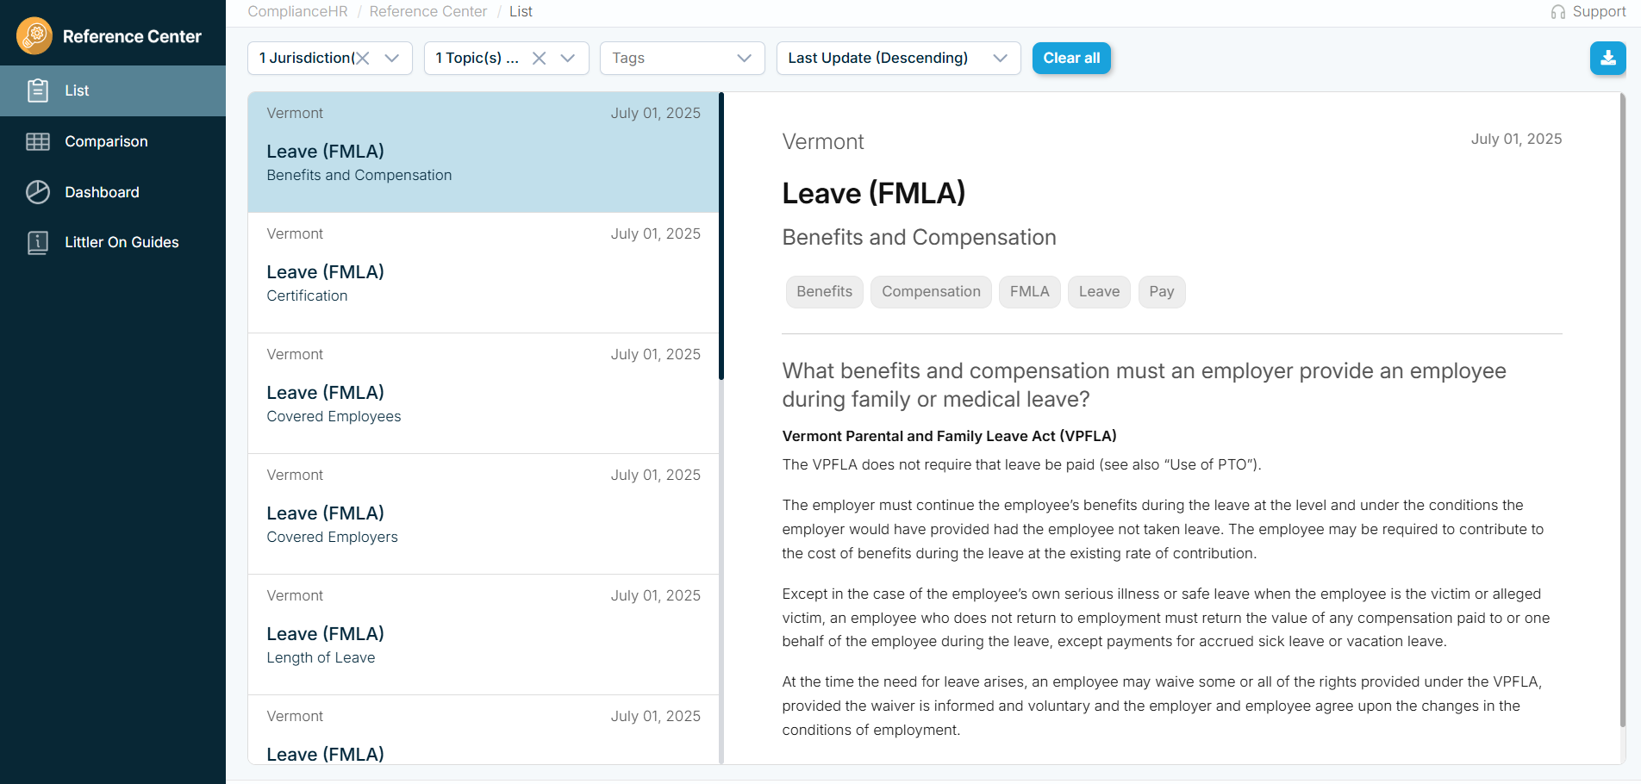
Rapid answer common HR questions on 30+ topics

Slide 6
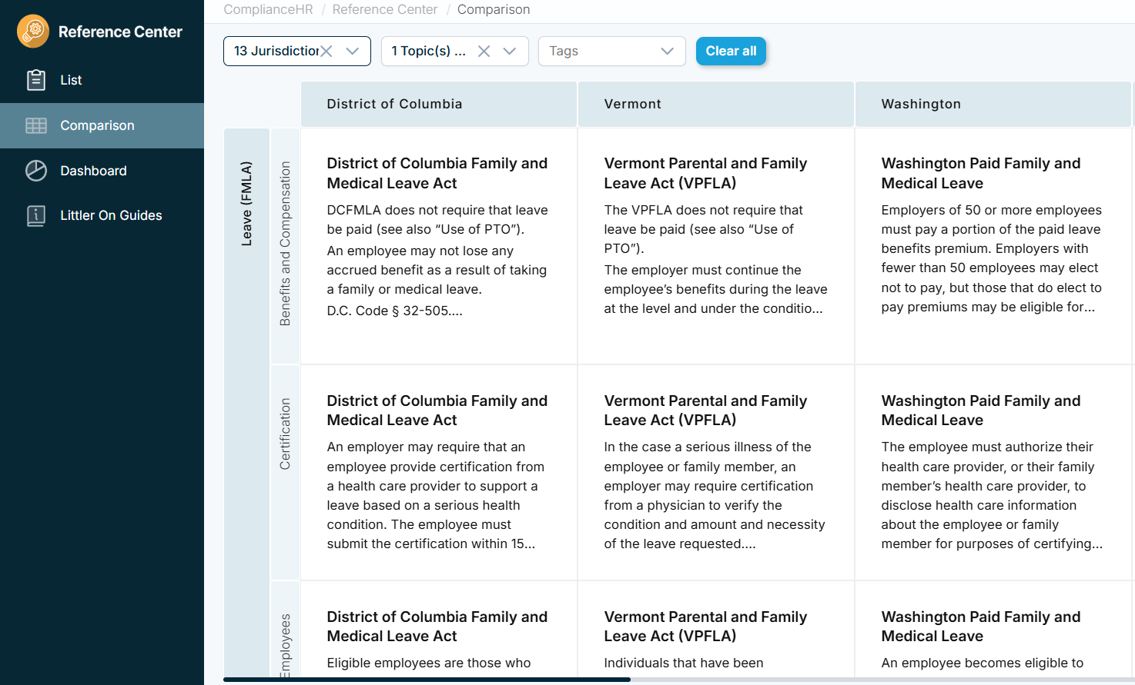
Easily compare requirements across jurisdictions

Slide 7
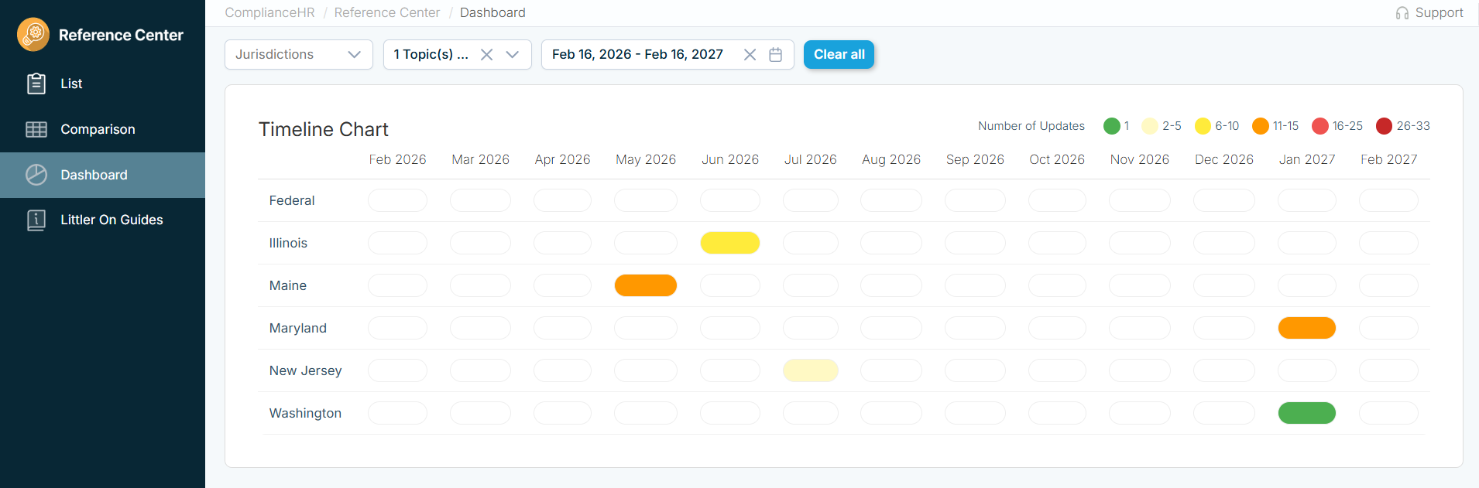
View all upcoming policy changes by state

Slide 8
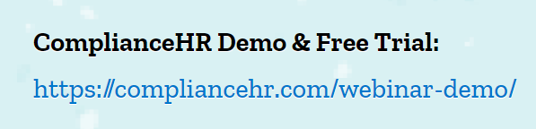
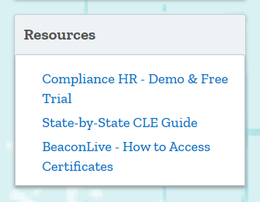
Sign Up for a Demo
Three ways to sign up for a demo:
Reply “Yes” to the on-screen poll
Visit our website: Compliancehr.com
Email our team at demo@compliancehr.com
Benefits of a custom demo:
Discuss your organization’s requirements/challenges
Review Navigator Suite Solutions
Share compliance methodologies

Slide 9

ROCIO BLANCO GARCIA
Shareholder
Miami, FL
Rblancogarcia@littler.com

Slide 10
What the FMLA Provides An Introductory Summary

Slide 11
FMLA Benefits
Unpaid, job-protected leave
Benefits continuation
Job Reinstatement
12 or 26 workweeks of leave in a 12-month period
No interference, no retaliation
It doesn’t matter how inconvenient this is

Slide 12




Ways You May First Learn of the Need for Leave
You realize that a time sheet or hours worked report looks different than usual;
An employee has poor attendance that is about to lead to discipline;
Employee raises an issue about her work schedule as it relates to a medical condition;
Employee explains during the course of a counseling or disciplinary meeting that he has a medical problem causing the performance deficiencies;

Slide 13


More Ways You May First Learn of the Need for Leave
Employee provides information—in person, via telephone, from a family member, etc.—about a medical problem that may require time off work, either on occasion, or all at once;
Manager notices a significant change in an employee’s behavior, work patterns or conduct and has reason to believe they may be related to a medical condition; and/or
Employee has an on-the-job injury which renders him unable to work for a period of time.

Slide 14

Practice Time
While attending a mandatory training, one of your employees who has been with the Company for a little over a year falls off the stairs, twisting his ankle and breaking both arms.
HR promptly advises the employee on how to submit a claim to workers compensation.
The employee needs 3 weeks off work, and then needs to be absent 5 hours per week to attend physical therapy
Is this an FMLA Issue? Workers Comp? Both?

Slide 15
Practice Time
One of your employees emails HR to state they are experiencing a mental health crisis and need a week off to unplug and get back “in the swing of things.” They also share they will need 2 hours off each week to do online therapy.
You send the employee FMLA paperwork, but the employee responds: “it is OK, I don’t need FMLA. I have enough PTO. Thank you, though!”
What should you do?

Slide 16
Common Myth – “FMLA is Optional”
Reality: if an employee is taking time off work for a reason that qualifies as FMLA, the Company has an obligation under the law to designate that time off as FMLA
This means neither employees, nor the Company, get to choose to “not use FMLA”
If the Company requires employees to provide documentation in support of their need for FMLA, and they don’t provide it, the time off work could be unexcused—even if the employee has paid time off available (but check state laws).

Slide 17
Designating Leave as FMLA
It is the employer’s burden to designate—and if we don’t have enough information, to ask for it
March 2019 and September 2019 DOL Opinion letters reinforce this
In other words, if leave is FMLA qualifying, and we fail to designate it as such, we have not complied with the FMLA
This includes people who fail to turn in the paperwork—pick up your designation duties as you normally would
Complaints by employees that they want to “save their time off” or that their doctor charges $25 for paperwork do not affect an employer’s legal obligations
Explain consequences of failure to cooperate with the process
BUT—cannot force an employee to take more leave than is medically necessary (arises most often in the intermittent leave context)

Slide 18
Who Can Take FMLA? Eligibility and Reasons for Leave

Slide 19
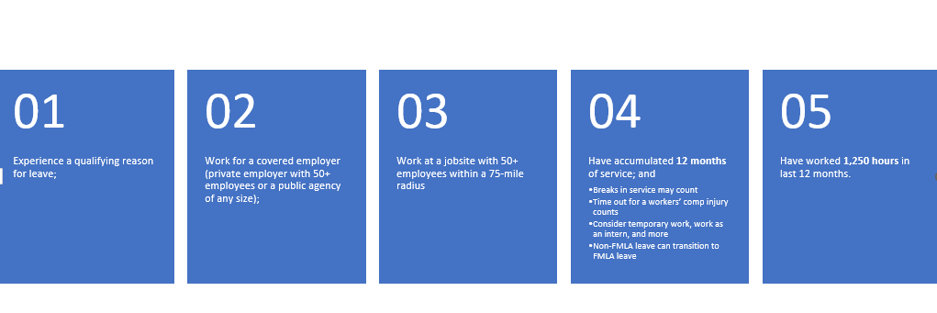
Eligible Employees

Slide 20
Practice Time
Peter needs leave for an upcoming surgery. He e-mails HR to inform that the surgery is scheduled for the next month and that he will have a recovery period of 21 days.
Peter works from his home in Alaska, but he does most of his work for the Company’s Miami office.
There are only 2 other employees brave enough to live in Alaska, but lots have been attracted to Miami’s warm weather (though not its cost of living). There are 125 employees in the Miami office, and Peter’s boss is one of them.
Is Peter eligible for leave under the FMLA given there are not 50 employees within a 75-mile radius?

Slide 21
Medical Reasons for FMLA Leave
Birth or placement of a child
To care for a spouse, parent or child with a serious health condition
The employee’s own serious health condition

Slide 22
Bonding Leave
Bonding leave is fundamentally different from serious health condition leave
Intermittent leave is available prior to birth or placement
For biological children, pregnancy and prenatal care is a serious health condition for mom and her spouse (marriage required)
For adoptive/foster, intermittent leave permitted before placement for legal obligations, home visits, and more
Once the child is born or placed
Not available intermittently once the child arrives
Moms and dads both get it
Doesn’t require medical certification because isn’t medically necessary
Marriage is not required
Spouses who both work for same employer can be required to split the 12 weeks of bonding time (do you do this?)
Can be taken any time within 12 months of the birth or placement

Slide 23

Serious Health Condition
An illness, injury, impairment or physical or mental condition that involves:
Inpatient Care (overnight stay or subsequent treatment in connection with that stay); or
Continuing Treatment
Incapacity of more than 3 consecutive days and
Visit 2+ times within 30 days; or
Visit plus a regimen of treatment (including Rx)
Pregnancy or prenatal care
Chronic conditions
Permanent or long-term conditions
Condition requiring multiple treatments

Slide 24

Family Members for Serious Health Condition Leave
Parent
Biological, adoptive, foster, step
No in-laws
In loco parentis
Child
Biological, adoptive, foster, step
In loco parentis
Under age 18 (unless mental/physical disability, or qualifying exigency leaves)
Grandma wants leave for her grandbaby?
Spouse
As long as “married” under state law
Including common law if state recognizes it

Slide 25

Leave to Care for a Family Member
Available where family member is unable to care for own basic medical, hygienic or nutritional needs (activities of daily living standard)
Also available for transport to and from medical appointments
Includes providing psychological comfort
Employee does not have to be only person available
But the standard for “providing care” may be decreasing...

Slide 26
Practice Time
Susan’s mother has been diagnosed with cancer.
Susan requests and is granted FMLA.
Susan has been taking leave intermittently to care for her mother.
While out on leave, Susan posts a story on Instagram showing herself in Cancun.
What should we do?

Slide 27
Amount and Types of Leave

Slide 28
Amount and Types of Leave
Blocks of leave
12/26 workweeks
Employee’s own workweek is the basis—so a week is a week
Intermittent/Reduced Schedule Leave
In hours or partial workweeks based on employee’s regular work schedule
Employee’s own workweek is still the basis (do they work 30 hours a week, or 60?)—make sure enough hours are being put in their FMLA leave bank
Get agreement from exempt employees about their regular work schedule
Watch out for requests we may incorrectly consider accommodation issues
Employee: “My doctor says I can only work 20 hours a week”
Supervisor: “We cannot accommodate that” or “we don’t have any part time jobs”
WRONG—this is a form of FMLA if someone is eligible

Slide 29
Intermittent/Reduced Schedule Leave
What it’s used for
Medical necessity and certain Military QE leaves
Periodic appointments, prenatal care/morning sickness, treatments, flare-ups of chronic conditions
Cannot necessarily require medical certification for each absence
Cannot force more than they need—the physical impossibility rule

Slide 30
Practice Time
Julie has ADHD, anxiety, and major depressive disorder. She experiences flare-ups, and when she does, she might need 1-2 days off work “every 2 weeks or so.”
HR provides Julie FMLA paperwork. Julie’s provider completes a certification attesting to the need for 1-2 days off work “every 2 weeks or so” for the next 7 months. These flareups are unpredictable, but the doctor is hoping that after a few months of medication management things will get better.
Julie has been calling out 2 days every 2 weeks. This has been going on for 10 weeks, and the manager is truly struggling with coverage when Julie is out. He is “fed up and cannot take it anymore!”
Not believing that Julie can possibly need so much time, the supervisor starts asking Julie for a doctor’s note every time she calls out.
Thoughts on the supervisor’s approach?

Slide 31
Establishing Eligibility for Intermittent Leave
An employee eligible for intermittent leave only needs to establish eligibility as of the first absence and not with each subsequent absence
Generally, employers cannot require a doctor’s note for any absences after right to intermittent leave has been established

Slide 32
Practice Time
Same fact pattern involving Julie, except that Julie’s pattern of absences looks as follows:
The absences are always on Monday and Friday
The absences have consistently averaged 4 days every two weeks
Now, can the supervisor ask for a doctor’s note?
Is there anything else that can be done?

Slide 33
Pay and Benefits During FMLA

Slide 34
Payment While on FMLA
General rule: FMLA leave is an unpaid leave right (i.e., the law does not require pay)
Wage replacement benefits (like short-term disability, workers’ compensation, etc.) are also NOT leave
Substitution of paid time off under Company policy (vacation, salary continuation, sick time, parental leave)—enables some or all of FMLA to also be paid, but does not extend the leave

Slide 35
Capturing and Documenting FMLA

Slide 36
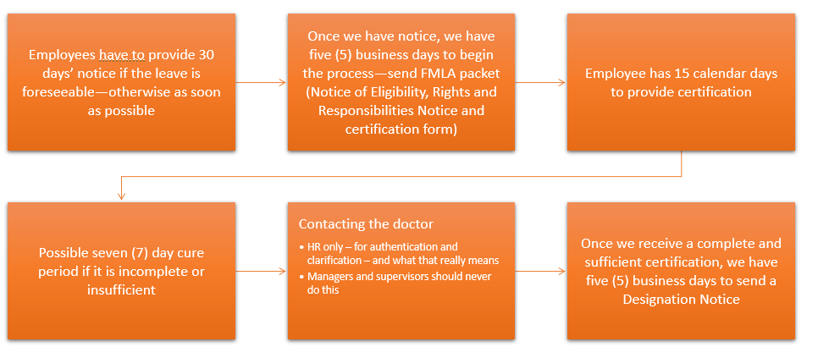
Certification Process

Slide 37
Practice Time
Judy has known for 2 months that she would need hip replacement surgery and that the surgery would take place March 2, 2026.
On February 11, 2026, she contacts HR to let them know about the upcoming surgery.
Can HR delay approval?

Slide 38
Strict Confidentiality
Anything related to an employee’s leave, need for accommodation, medical visits, etc. is a confidential medical record
Stored separately, under “lock and key” (whether virtual or real)
Share on a need-to-know basis only
Consider how information is received and transmitted
And remember: we are only entitled to job-related information regarding an employee’s need for leave or accommodations (not the underlying diagnoses, medications, treatment plans and more)

Slide 39
Returning to Work

Slide 40
Practice Time
Joe’s wife had a baby 2 months ago. Joe has been on FMLA bonding leave enjoying their new “bundle of joy.”
While Joe has been basking in the joy of parenthood, your company has been struggling. The end of year numbers were not nearly as good as you had hoped, and to make matters worse, you just lost $10 million in funding.
You are conducting a RIF, and Joe will be included in it.
Can Joe be included in the RIF while out on leave?

Slide 41
Reinstatement
Reinstatement to the “same or equivalent position”
“Virtually identical:” same pay, same shift, same benefits, same worksite, same duties, etc.
If the employee can perform the essential job functions (with or without an accommodation)
Remember, no such thing as “undue hardship”
There is “no greater right” than if they had been at work
BUT: incredibly high risk of terminating employees while on leave, or immediately after their return

Slide 42
What if the employee Cannot Return After 12 weeks?
(or never qualified for FMLA in the first place?)

Slide 43

Practice Time
Your newest employee has been with you for six months, and suddenly he reveals he has been diagnosed with cancer and asks to take a three-month leave immediately for treatment.
You know FMLA leave is not available until he has been with the Company for at least 12 months.
Where do we go from here?

