Slide 1
Independent Contractor or Employee?
Why Labels Don't Protect You Under the FLSA

Slide 2
Introduction to ComplianceHR

Slide 3
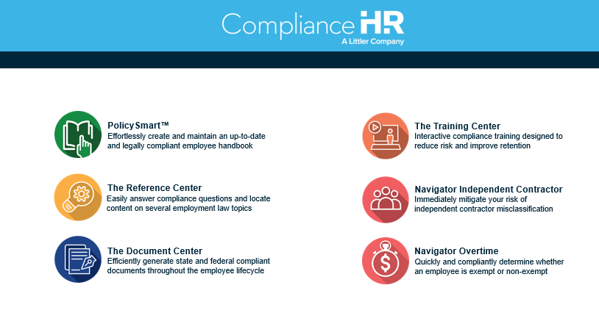
Simplify the Complexity of Employment Law

Slide 4

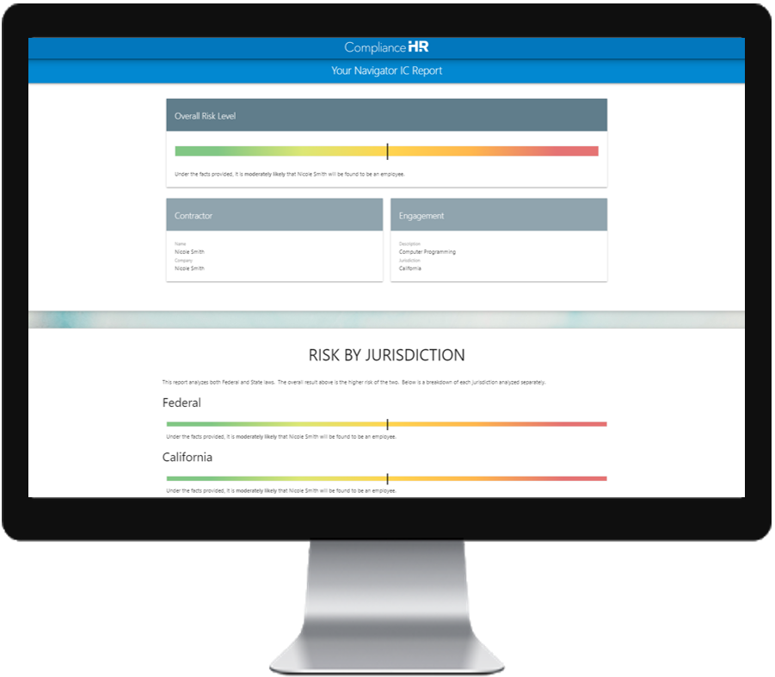
Navigator Independent Contractor
Determines employee or independent contractor status
Draws from a proprietary engine of 1,900 reported court decisions and DOL opinion letters
Analyzes individual fact patterns under all applicable federal and state regulations
Delivers an actionable risk assessment, a report on how to lower the risk of misclassification, a summary of applicable laws, and a transcript of questionnaire answers

Slide 5
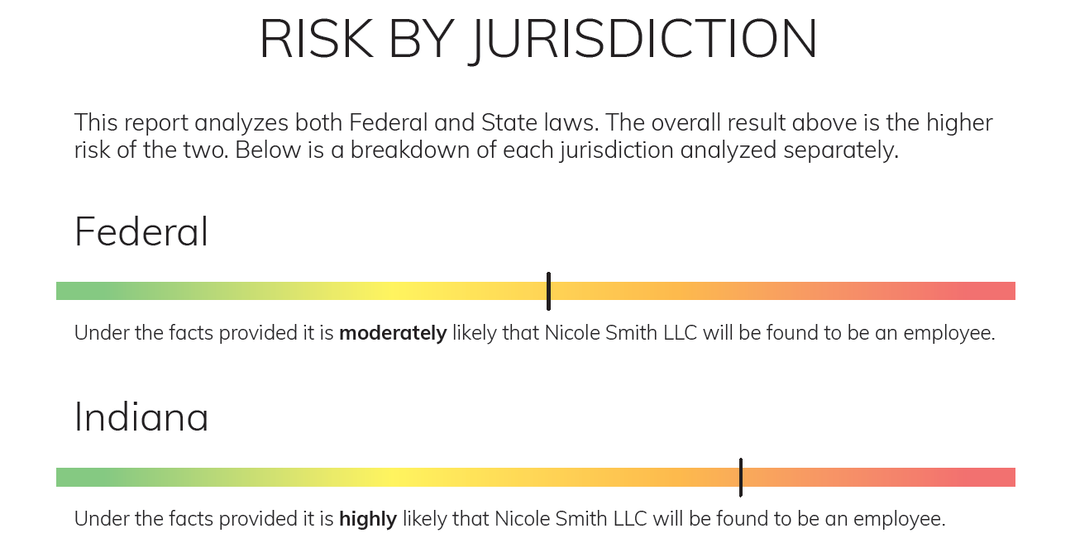
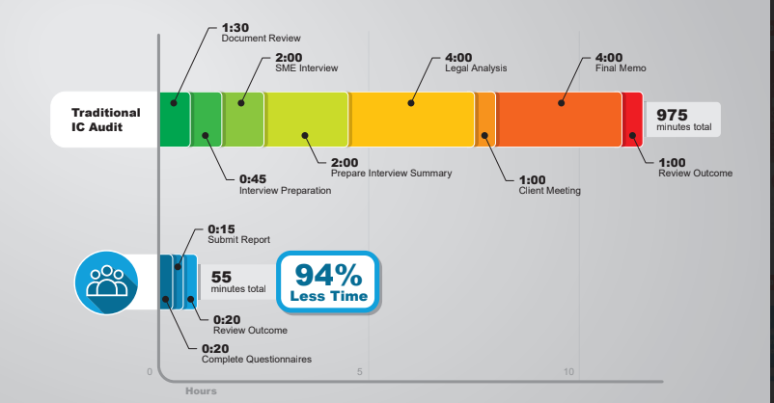
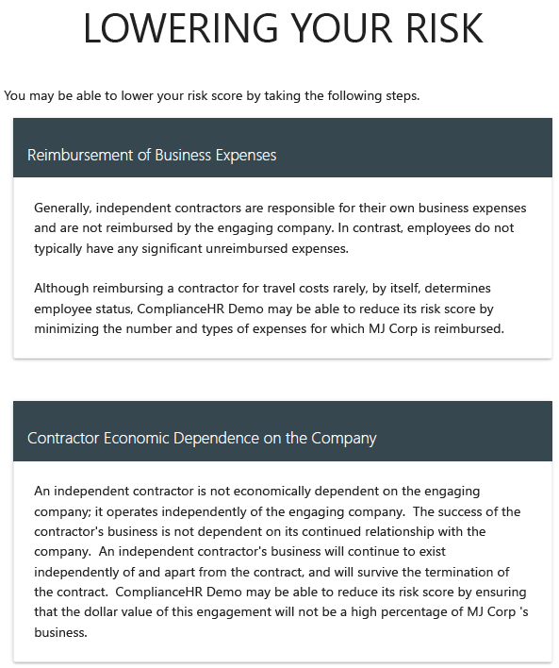
Immediate Expert Guidance

Slide 6


Sign Up for a Demo
Three ways to sign up for a demo:
Reply “Yes” to the on-screen poll
Visit our website: Compliancehr.com
Email our team at demo@compliancehr.com
Benefits of a custom demo:
Discuss your organization’s requirements/challenges
Review Navigator Suite Solutions
Share compliance methodologies

Slide 7
Lots of Names / Lots of Tests
The labels:
Employee
Full-time, part-time, hourly, temporary, seasonal
Contingent Worker
Consultant / Contractor
Independent Contractor
The tests:
The common-law rules or common-law control test
The economic realities test
The hybrid test; and
The ABC test

Slide 8

If You Remember One Thing From Today…

Slide 9
Who is an “Independent Contractor”
Key Term is “Independent”
Independent contractors are separate businesses and not your employees, even if they consist of only one person.
Independent contractors are economically independent
Contract language or the freelancer’s preference do not control the determination; the court will look at the actual relationship of the parties.
The more control exerted by the principal, the more likely the worker is an employee.
The default status is an employment relationship.

Slide 10
Classic Independent Contractor: The Plumber
The Plumber or the CPA:
Operates her own business
Works for several clients
Has specialized skills, different from your business
Sets her hours, decides how much to charge for her time, and works on a project basis
Exercises independence in the mode and way the work gets done
Purchases her own equipment and supplies
You do not control her work or her hours

Slide 11
Most Workers Are Employees
FLSA defines “employ” as “to suffer or permit to work”
“Broadest definition of employment under the law because it covers work that the employer directs or allows to take place.”
Temp or contingent worker who is placed on-site may still be employee, if you exert sufficient control
PEO’s (Professional Employer Organizations) or Staffing Agencies: May be responsible for taxes, worker’s comp., etc., but if the service recipient exercises discretion and control over services, it may be considered a joint employer

Slide 12
Myths v. Realities
Realities:
How the parties label things is almost meaningless
A worker’s “acknowledgement” that they are an independent contractor does not make them an independent contractor
The fact someone is paid on a 1099 does not make them an Independent Contractor
The fact someone doesn’t need benefits or declines benefits, does not mean you can make then an independent contractor

Slide 13

“Misclassified employees are often denied access to the critical benefits and protections they are entitled. Misclassification also generates substantial losses to the federal government and state governments in the form of lower tax revenues, as well as to state unemployment insurance and workers’ compensation funds. It forces workers to pay the entirety of their payroll (FICA) tax. It also tips the scales against all of the employers who play by the rules and undermines the economy.”
13

Slide 14
Who Cares?
The classification of who is an employee is very important because:
Most federal and state labor laws protect only employees and not independent contractors
Failure to properly classify an individual as an employee can make the employer liable:
For minimum wage and overtime requirements (together with liquidated damages and penalties for violations)
Former independent contractors can claim entitlements given to employees, such as health insurance, pension plan participation, and other employer provided benefits, as well as unemployment insurance and disability benefits
The IRS can go after the employer for failure to withhold income tax and make other appropriate payroll deductions

Slide 15

The Risks:
How Bad Could it Be, Really?

Slide 16

Risks for Misclassifying Workers as ICs: Pressure From All Sides
Federal agencies, state agencies, labor unions, and other advocates focused on stopping “wage theft” resulting from IC misclassification
DOL
States Agencies
A Perfect Storm
IRS
Unions

Slide 17
Risks for Misclassifying Workers as ICs: Liability Goes Far Beyond Unpaid Overtime
Retirement
Stock Options
Workers’ Comp
Unemployment
Affordable Care Act
Title VII/ADA/ADEA
Taxes

Slide 18

The IC Tests Under Federal and State Laws

Slide 19
Over 100 Different Legal Tests in the US
IRS 20-Factor Test
Darden
Common Law Test
Over 100 State Law Tests
FLSA Economic Reality Test
Federal law alone has multiple different tests for determining IC status
Layered on top of these, states may have up to six different tests under different laws
There is however a theme to these tests….

Slide 20

IRS “20 Factors”
No instructions
No training
No integration
Services do not have to be rendered personally
Control over assistants
No continuing relationship
Work hours
Time to pursue other work
Job location
No requirements on the order or sequence of work
No required reports
Payment for the result
Business expenses
Own tools
Significant investment
Possible profit or loss
Working for multiple firms
Services available to the general public
Limited right to discharge
Liability for non-completion

Slide 21
Over 100 Different Legal Tests in the US
IRS 20-Factor Test
Darden
Common Law Test
Over 100 State Law Tests
FLSA Economic Reality Test
Federal law alone has multiple different tests for determining IC status
Layered on top of these, states may have up to six different tests under different laws
There is however a theme to these tests….

Slide 22
Darden Common Law Test
The skill required
The source of the instrumentalities and tools
The location of the work
The duration of the relationship between the parties
Whether the hiring party has the right to assign additional projects to the hired party
The extent of the hired party's discretion over when and how long to work
The method of payment
The hired party's role in hiring and paying assistants
Whether the work is part of the regular business of the hiring party
Whether the hiring party is in business
The provision of employee benefits
The tax treatment of the hired party
*Nationwide Mut. Ins. Co. v. Darden, 503 U.S. 318 (1992)

Slide 23
Over 100 Different Legal Tests in the US
IRS 20-Factor Test
Darden
Common Law Test
Over 100 State Law Tests
FLSA Economic Reality Test
Federal law alone has multiple different tests for determining IC status
Layered on top of these, states may have up to six different tests under different laws
There is however a theme to these tests….

Slide 24
Beware of State Law
Variety of State Tests
Versions of Economic Realities
Agency Test
Right to Control/Common Law tests – New York uses this test for fair employment practices laws and Unemployment Insurance determinations

Slide 25
The ABC Test
ABC Test
(A) ABSENCE of Control: Contractor must be able to control their work
(B) The BUSINESS is performed outside the usual course of business or performed away from the place of business
(C) The work is CUSTOMARILY performed by independent contractors
Very difficult test to pass
3 states use this test for all purposes (CA, MA, and NJ)
But a number of states use it for some purposes

Slide 26
Over 100 Different Legal Tests in the US
IRS 20-Factor Test
Darden
Common Law Test
Over 100 State Law Tests
FLSA Economic Reality Test
Federal law alone has multiple different tests for determining IC status
Layered on top of these, states may have up to six different tests under different laws
There is however a theme to these tests….

Slide 27

Trump 1.0 – Withdrawal of DOL Memo re IC Status
June 2017:
Secretary of Labor announced withdraw of prior guidance issued by the DOL re joint employment and independent contractor status under the FLSA.
The DOL’s prior guidance expressly stated that “most workers are employees under the FLSA’s broad definitions,” essentially creating a presumption of employment for workers.
The withdraw of the guidance signaled efforts to rein in the expansive interpretation of “employment” that had evolved under the prior administration.

Slide 28
Biden – DOL Withdraws Independent Contractor Regulations, Meaning More Uncertainty for Employers
On May 6, 2021, the U.S. Department of Labor formally withdrew final regulations promulgated earlier under the Trump administration.
These regulations (the “Independent Contractor Rule” or “Final Rule”) clarified the relevant factors the DOL would use to determine whether workers are in business for themselves and are independent contractors, or are economically dependent on a putative employer for work and thus employees under the FLSA.
The withdrawal of the Final Rule means that employers will have less clarity as to how courts and the Department will determine independent contractor status under the FLSA. Courts have used a variety of different tests, making predictability and consistency, particularly for national employers, difficult.
The Department will take a more aggressive approach towards enforcement of worker classification laws, and dramatically narrow the class of workers who may be properly classified as independent contractors under the law.

Slide 29
The FLSA Rule (As of March 11, 2024)
Multifactor analysis based on 6 factors that guide the analysis of a worker’s relationship with an employer:
Any opportunity for profit or loss a worker might have;
The financial stake and nature of any resources a worker has invested in the work;
The degree of permanence of the work relationship;
The degree of control an employer has over the person’s work;
Whether the work the person does is essential to the employer’s business;
The worker’s skill and initiative

Slide 30
Trump 2.0 – DOL Enforcement “Pause”
On May 1, 2025, the DOL issued Field Assistance Bulletin 2025‑1, announcing that it would:
Stop enforcing the 2024 Rule in agency investigations.
Revert enforcement back to the 2008 Fact Sheet #13 and the economic‑reality test described there.
Continue reviewing whether to retain or rescind the 2024 Rule.

Slide 31
Profit or Loss
Does the worker’s managerial skill affect the worker’s opportunity for profit or loss?
An IC’s decisions to hire others, purchase materials and equipment, advertise, rent space, and manage time tables may reflect managerial skills that will affect his or her opportunity for profit or loss beyond a current job.
On the other hand, the worker’s ability to work more hours and the amount of work available from the employer have nothing to do with the worker’s managerial skill and do little to separate employees from independent contractors
The effect on one’s earnings of doing one’s job well or being technically proficient is unrelated to an individual’s ability to earn or lose profit via his managerial skill,

Slide 32
Investment
How does the worker’s relative investment compare to the employer’s investment?
An independent contractor typically makes investments that support a business as a business beyond any particular job. The investment of a true independent contractor might, for example, further the business’s capacity to expand, reduce its cost structure, or extend the reach of the independent contractor’s market.
The worker’s investment should not be relatively minor compared with that of the employer.
Investing in tools and equipment is not necessarily a business investment or a capital expenditure that indicates that the worker is an independent contractor.

Slide 33
Investment - Examples
Rig welders’ investments in equipped trucks costing between $35,000 and $40,000 did not support IC status when compared to company’s investment in its business.
Cake decorators’ $400 investment in their tools not sufficient to support IC status.
Strawberry growers’ investment in hoes, shovels, and picking carts insufficient.
A worker providing cleaning services who invests in a vehicle not suitable for personal use, rents her own space to store the vehicle and materials, advertises and markets her services, purchases supplies and equipment, and hires a helper for larger jobs may be indicative of an independent contractor.

Slide 34
Length of Relationship
Is the relationship between the worker and the employer permanent or indefinite?
Permanency or indefiniteness in the relationship with the company suggests that the worker is an employee.
An independent contractor typically works one project for a company and does not necessarily work continuously or repeatedly for an employer.
However, a lack of permanence or indefiniteness does not automatically suggest an IC relationship. The reason for the lack of permanence or indefiniteness should be carefully reviewed to determine if the reason is indicative of the worker’s running an independent business.

Slide 35
Control
What is the nature and degree of the employer’s control over the work?
The worker must control meaningful aspects of the work
The control must be more than theoretical—the worker must actually exercise it.
Exercising control due to the nature of the business, regulatory requirements, or to ensure customers are satisfied still indicates that the worker is an employee.
The “control” factor should not play an oversized role in the analysis. The FLSA covers workers even if the employer does not exercise control if the workers are economically dependent on the employer.

Slide 36
Essence
Is the work an integral part of the employer’s business?
If the work performed by a worker is integral to the employer’s business, it is more likely that the worker is economically dependent on the employer.
Work performed by cake decorators “is obviously integral” to the business of selling cakes which are custom decorated.
Picking the pickles is integral to the pickle business.
A worker answering calls at a call center along with hundreds of others is performing work integral to the call center’s business.

Slide 37
Skill and Initiative
Does the work performed require special skill and initiative?
A worker’s business skills, judgment, and initiative, not his or her technical skills, will aid in determining whether the worker is economically independent.
The fact that workers are skilled is not itself indicative of independent contractor status. Even specialized skills do not indicate that workers are in business for themselves.
The technical skills of cable installers, carpenters, construction workers, and electricians, for example, even assuming that they are special, are not themselves indicative of any independence or business initiative.

Slide 38
What Does This Mean for Private Litigation?
Galarza v. One Call Claims, LLC
Published: October 16, 2025
Court: U.S. Court of Appeals for the Eleventh Circuit
It is the most important federal appellate decision on FLSA contractor–employee status in 2024–2026.

Slide 39
What Does This Mean for Private Litigation?
What the Eleventh Circuit Held
Explicitly reaffirmed the DOL six‑factor test.
Five of six economic‑reality factors favored employee status.
The adjusters were likely employees, not contractors.
“If a jury could not reasonably find that the workers were economically dependent under these facts, it’s not clear that a professional working from home could ever establish economic dependence under the FLSA.”

Slide 40
What Does This Mean for Private Litigation?
Alignment Between Galarza and the 2024 Rule
Both use a six‑factor, totality‑of‑circumstances / economic‑reality test.
Both emphasize actual working conditions, not contract language.
Both reject the idea that any factor (e.g., control or profit/loss) should dominate the analysis.

Slide 41

Red Flags re IC Classification
IC performs same work as employees under same conditions (!!!)
IC is paid by the hour, not by the project
Company provides training
Company controls hours worked
Company provides tools or equipment
IC cannot refuse or negotiate work
Work is performed on a “full-time” basis and relationships are long-term and continuous.
Company controls manner and means of completing the work
Undefined duration of relationship

Slide 42

Best Practices

Slide 43

Understand Key Risk Areas
Lack of due diligence with respect to potential business partners
Written agreements that reserve more control than necessary with respect to terms and conditions of employment
Lack of training and auditing of “on the ground” practices and supervision
Nature of work performed/interaction with “regular” employees (performance of core functions)
Management overlap/shared services/procedures (parent/sub – franchisor/franchisee)

Slide 44
Tips to Reduce Misclassification Claims
Use contractors who have their own employees
Ensure contractors are properly licensed with active accounts
Avoid engaging a former employee as a contractor
Avoid converting an employee to an independent contractor
Avoid being a contractor’s first customer
Avoid engaging a sole proprietor who will do the same work / under similar conditions as employees
Request documentation and audit
Consider express “term limits” for independent contractors

Slide 45
Tips to Reduce Misclassification Claims
Do not prohibit ICs from working for other companies
Do not provide training, instruction or otherwise attempt to control how work is performed
Limit review of IC work to quality control, compliance with contract specs
Do not provide tools or equipment
Do not reimburse for business expenses
Follow contract terms when terminating the engagement

Slide 46

Tips to Reduce Misclassification Claims
Contracts:
Should have contract with each contractor
Contract should consider all applicable state and federal laws
Contract should be customized to cover the services and arrangements for specific engagement
Contract should be fully executed (i.e., signed)
Update contract as circumstances change or as needed

Slide 47
Other Considerations
Written waivers of your benefits by contingent employees and contractors can help immunize you against claims for your benefits.
Arbitration agreements are enforceable for classification claims, so consider whether to require same for all contingent workers.
Make sure your benefit plans, compensation plans, fringe benefits, and other policies and plans clearly distinguish your employees from independent contractors and that they exclude all workers (including contractors) that are not your direct employees.

Slide 48

Is a Staffing Company the Answer?
Weigh benefits of arrangement and joint employer risk
Choose vendors carefully (solvency/competency)
Insist agency/labor provider be the employer (i.e., W-2s!)
Reduce “reserved control” in agreements
Reduce “actual control” on the ground
Indemnity clauses
Avoid contracting for “same work”/side-by-side arrangements (staff augmentation) – especially for IC arrangements
Limit duration of arrangement
Avoid “cost plus” or other billing arrangements tending to show control over wages

Slide 49
Tips to Negate Indicia of Control
Include disclaimer language: end-user and supplier are not joint employers – supplier is independent contractor, sole employer of the workers in question and solely responsible for wages, benefits (e.g., health insurance, workers’ compensation), etc. of supplier’s workers
Provide that supplier has right to control the workers with sole right and obligation to provide and exercise supervision
Provide that end-user shall not participate in wage rates, hiring, firing, promotion, demotion or disciplinary decisions of supplier’s employees

Slide 50

Revise Applicable Documents
Any agreements, handbooks, policies, manuals, communications, etc. that may apply to the contingent worker or contractor arrangement should be reviewed
Remove or modify red flag provisions that impose or reserve control over terms and conditions of temp employment or contractor engagement or dictate manner and method of the work performed

Slide 51
Managing Assignment Tasks v. Managing the Employment Relationship
Staffing firms and their customers divide co-employment duties according to their respective businesses.
When an issue of responsibility comes up, ask “Whose business is it?”
If it’s your business (i.e., the operational part of employing the contingent workforce) – it’s your duty.
If the business is staffing related (i.e., the HR part of employing the contingent workforce) – it’s the duty of the Staffing firm.
Conduct periodic reality checks.

Slide 52
Best Practices for Working with Staffing Companies
Require staffing firms to employ workers on a W-2 basis. This will cause the staffing firms to take responsibility for workers’ comp, wage and hour, benefits, and other employer obligations.
Clearly differentiate between employees and independent contractors in Company emails, directories, building access, and electronic access. Include a disclaimer indicating the individual is a contractor, consultant, or similar phrase. Do not provide independent contractors with Company business cards.
Conduct separate onboarding and provide separate onboarding materials to Company employees on the one hand and Independent Contractors on the other hand. Do not provide independent contractors with company handbooks.
Hold separate staff meetings and town halls to the extent practicable so that employees and independent contractors are treated separately.
Limit the equipment Company provides to independent contractors.
Independent Contractors should possess the skills necessary to complete their professional services. To the extent Company provides an independent contractor with training, it should not be focused on professional proficiency, which the individual should already possess.
Negotiate a pay rate with the staffing firm then allow the staffing firm to determine the independent contractor’s pay rate. (And of course, never pay overtime or any bonus)

Slide 53
Best Practices for Working with Staffing Companies
Require the staffing provider to complete traditional employer tasks, such as:
Provide staffing firms with the criteria for the position, and allow the staffing firm to interview, select, and background check candidates. Company managers should have no to a minimal role in the interview and selection process. Company should not advertise for employment opportunities for temporary worker positions. Company can hold the staffing firm accountable if a Contingent Worker is not meeting the contractual requirements (i.e. not fulfilling the duties of the role). The goal is to manage the staffing relationship, not individually assigned workers.
Do not permit managers to discipline, terminate, or give performance reviews to Contingent Workers, and instead rely on the provider to do so.
Do not micromanage schedules for Contingent Workers. Instead, inform the provider what needs you have and let the provider make appropriate scheduling decisions. Continue to use separate timekeeping systems for employees and contingent workers.
Do not make the decision on requests for time off for Contingent Workers. Instead, allow the provider to make this determination so long as the contracted work is being covered.
Do not make pay decisions or recommendations for Contingent Workers. Allow the provider to do this.

Slide 54
Best Practices for Working with Staffing Companies
Avoid assigning the same type of work to contingent workers that you assign to employees.
If you must assign the same type of work to contingent workers that you assign to employees, differentiate the roles as much as possible.
Change the description of the position and tasks assigned to differentiate contingent workers from employees.
Limit the contingent worker’s access to only essential systems, and only the essential parts of those essential systems.
Allow staffing firm to control as much as possible.
Exercise limited control over the contingent worker’s work product, supervision, schedule, pay, etc.
The more control the Company exercises over the contingent worker, the higher the risk the Company may be held liable as a joint employer.

Slide 55
Dos and Don’ts
Do let the staffing firm do the recruiting, screening, selection, and assigning. Resist the temptation to become part of the hiring process. An exception to this is “payrolling,” whereby design or by circumstance you do the recruiting.
Do let the staffing firm, as the payroll employer, determine the exact wages and benefits of the assigned workers. You and your staffing firm agree on the bill rates to be paid.
Do let independent contractors manage themselves, the assigned work/projects and any staff that they may have.
Do include staffing firm employees in your business and social events, except for gatherings that are specifically for your direct employees only (like benefit plan rollouts). But funnel the social invitations through the staffing firm. This does not include contractors.
Do have distinctive badging and identification for contingent workers, including independent contractors.
Do refer separately to the contingent worker populations in announcements, memos, etc. that affect them.
Don’t make contingent employees report their tardiness or absences to your supervisors. Let them call the staffing firm, who will call you and work with you on disability and family leave issues.
Don’t change a contingent employee’s overall work assignment (manager, location, job code, etc.) without consulting with the staffing firm. Don’t let supervisors create in contingent workers the impression or expectation of direct employment with you.
Don’t direct independent contractors on when, where, why or how to complete a project or perform work. Contractors should only be given details on project completion dates and specifications.

Slide 57
D. Porpoise Evans
Managing Shareholder
Miami Office
DPEvans@littler.com
Direct: (305) 400-7515

Slide 58
Quiz
A staffing firm hires X and sends X to perform a long-term accounting project for a client. X’s contract with the staffing firm states that she is an IC; that she retains the right to work for others, but X spends substantially all of her work time performing services for the client, on the client’s premises. The client supervises X, sets her work schedule, provides the necessary equipment and supplies, and specifies how the work is to be accomplished. X reports the number of hours she has worked to the staffing firm. The firm pays her and bills the client for the time worked. The staffing firm reviews X’s work based on reports by the client and has the right to terminate her if she is failing to perform the requested services. The staffing firm will replace her with another worker if her work is unacceptable to the client.
Per EEOC: The Staffing Firm and Client are Joint Employers of X.

Slide 59
IC or Employee?
Engineering company enters into a contract with the retiring VP of Consulting Services to perform engineering consulting as an independent contractor
The VP will continue to work out of her current office
The contract prohibits the VP from performing engineering consulting work for any of the company’s competitors
The VP will perform all the work herself
The VP will be paid based on hours worked

Slide 60
IC or Employee?
Food Manufacturer enters a contract with Jane Jones to assist in implementing a new SAP distribution software system
The project will take 18 months. During that time, Jane will be working exclusively on this project
Jane is a recognized expert, has assisted many companies implement SAP
All work will be performed at the HQ of the Company
Jane will be paid a fee of $500,000 in 12 equal monthly installments for the project, with bonuses available if the work is completed on time and on budget

